Slide 1
Public Group meeting (25/9)
Somdeepa Das

Slide 2
Introduction slides
Describe local option elections, and what variation in creates in terms of alcohol availability, sales and so on…
Briefly discuss how you can link this variation to other outcomes – traffic accidents and deaths, morbidity, local government revenues (from taxes)
Work up to now has been to check what is the first-order effect of these local option elections – does the policy have ‘bite’, if so, in what way?
First, I check whether a city gets more drinking establishments after it switches from being ‘dry’ to ‘wet’

Slide 3
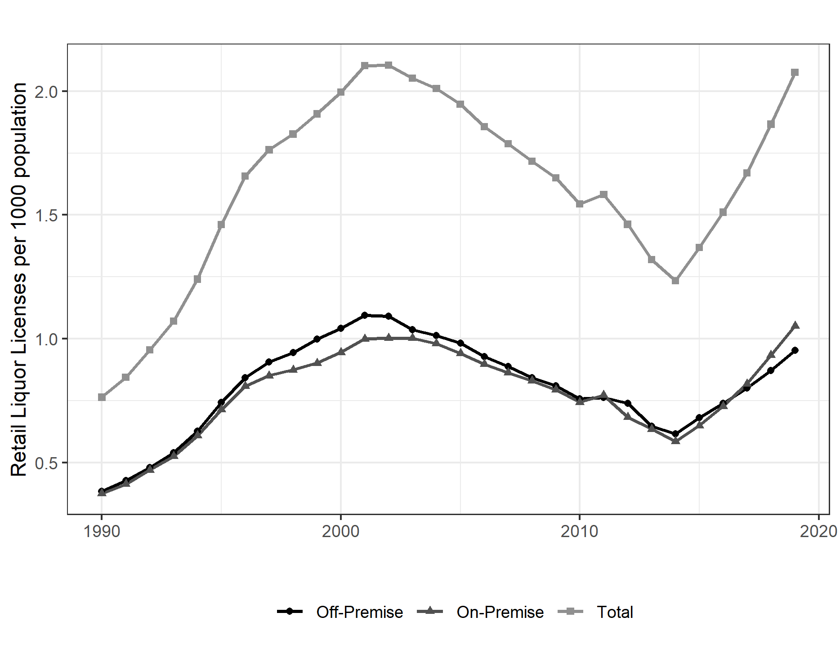
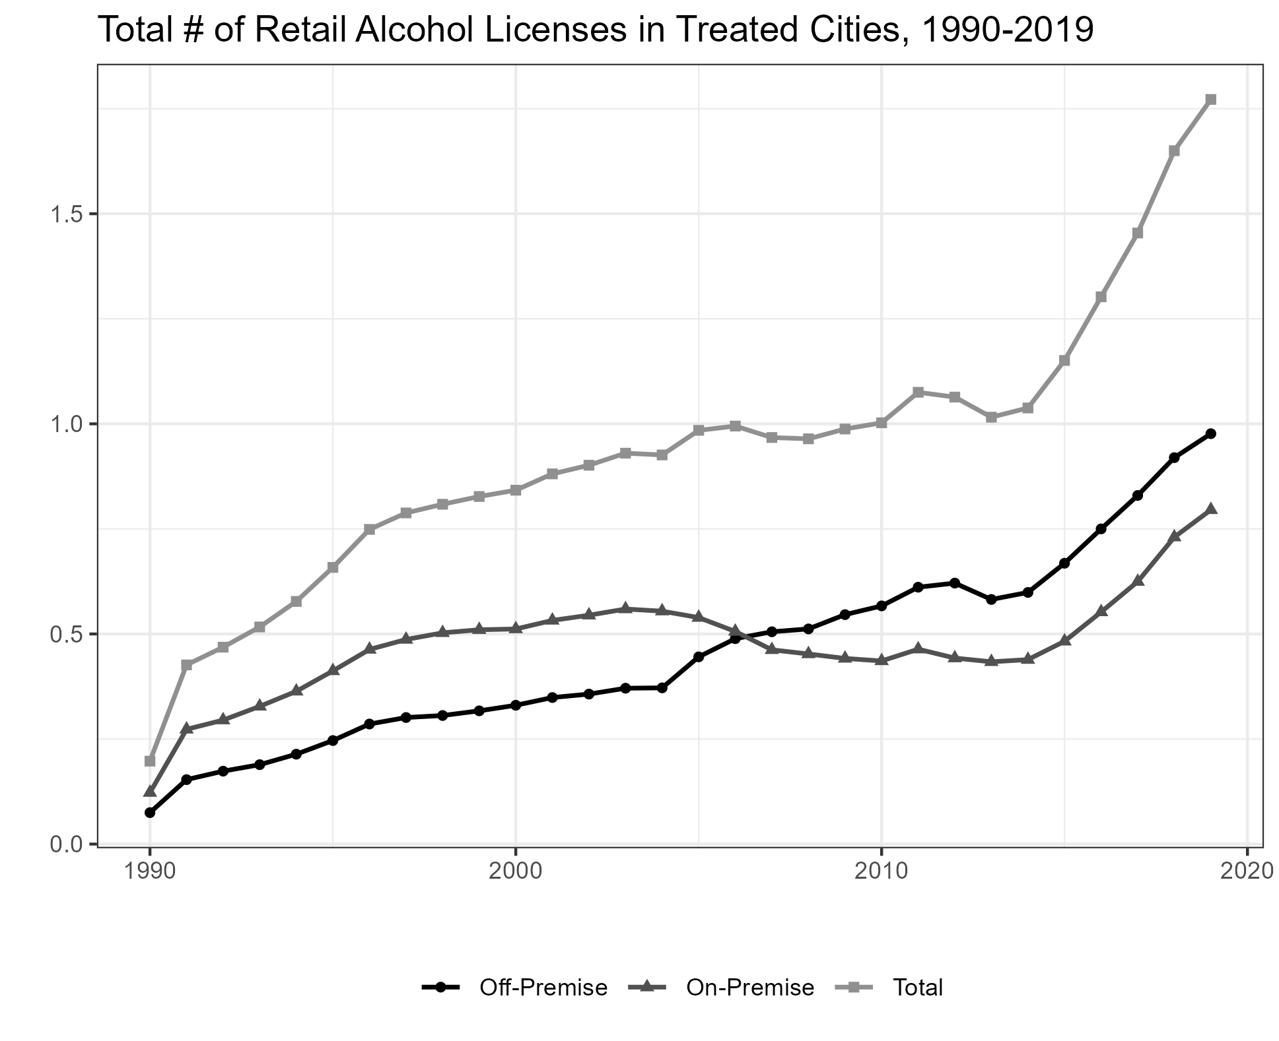
Trends in Licenses
All Texas, 1990-2019

Slide 4
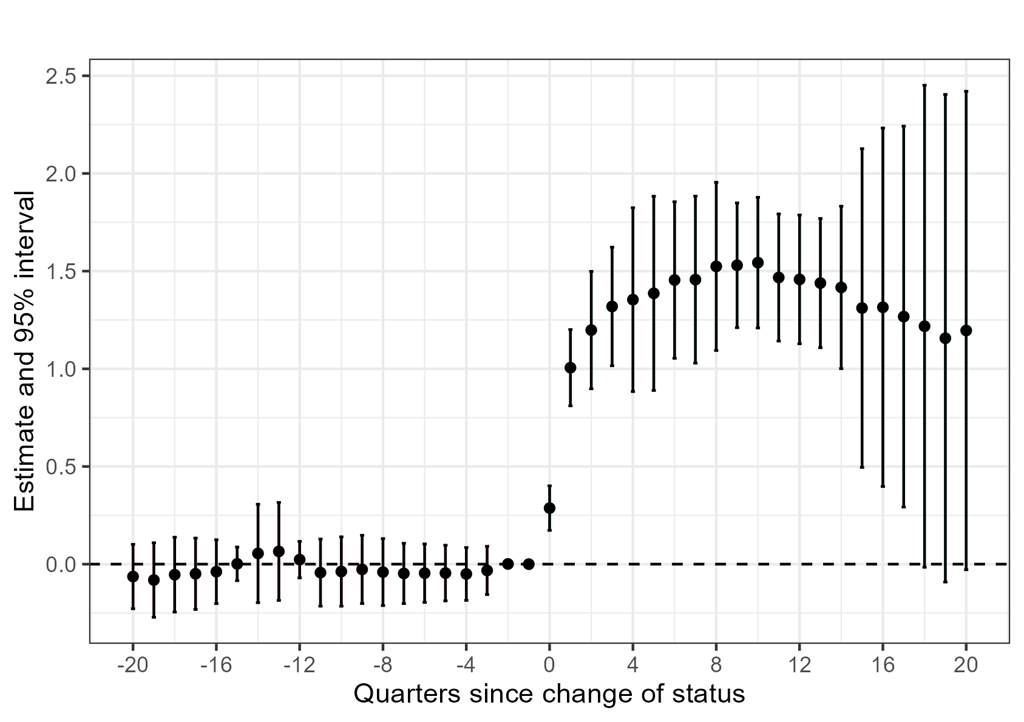
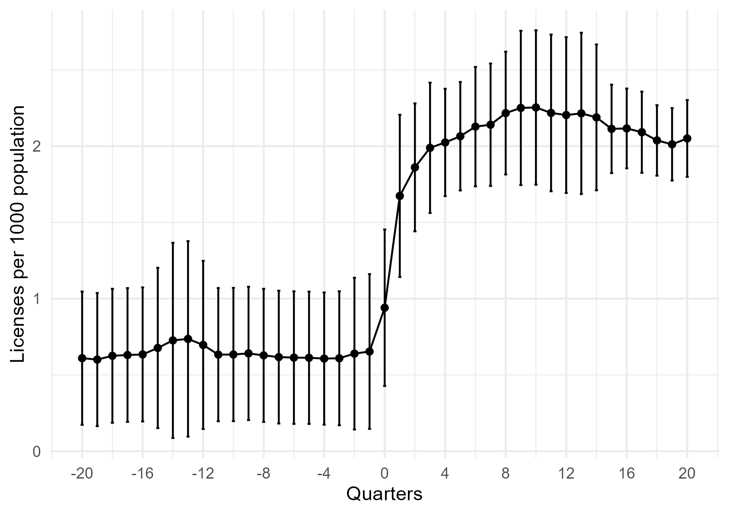
First-Stage results from the policy change (Event Study)

Slide 5
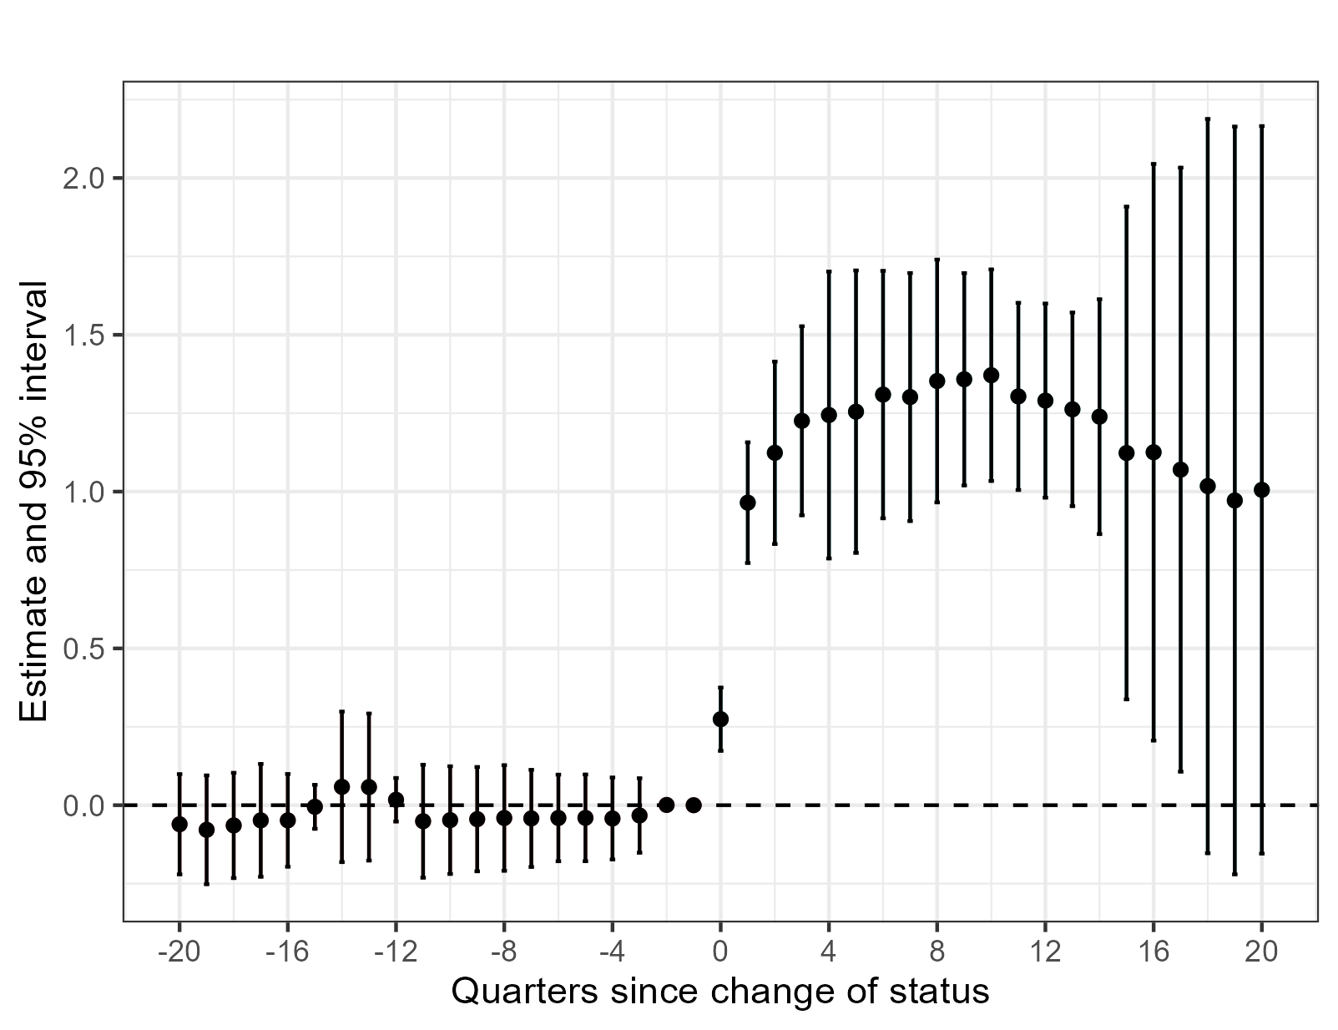
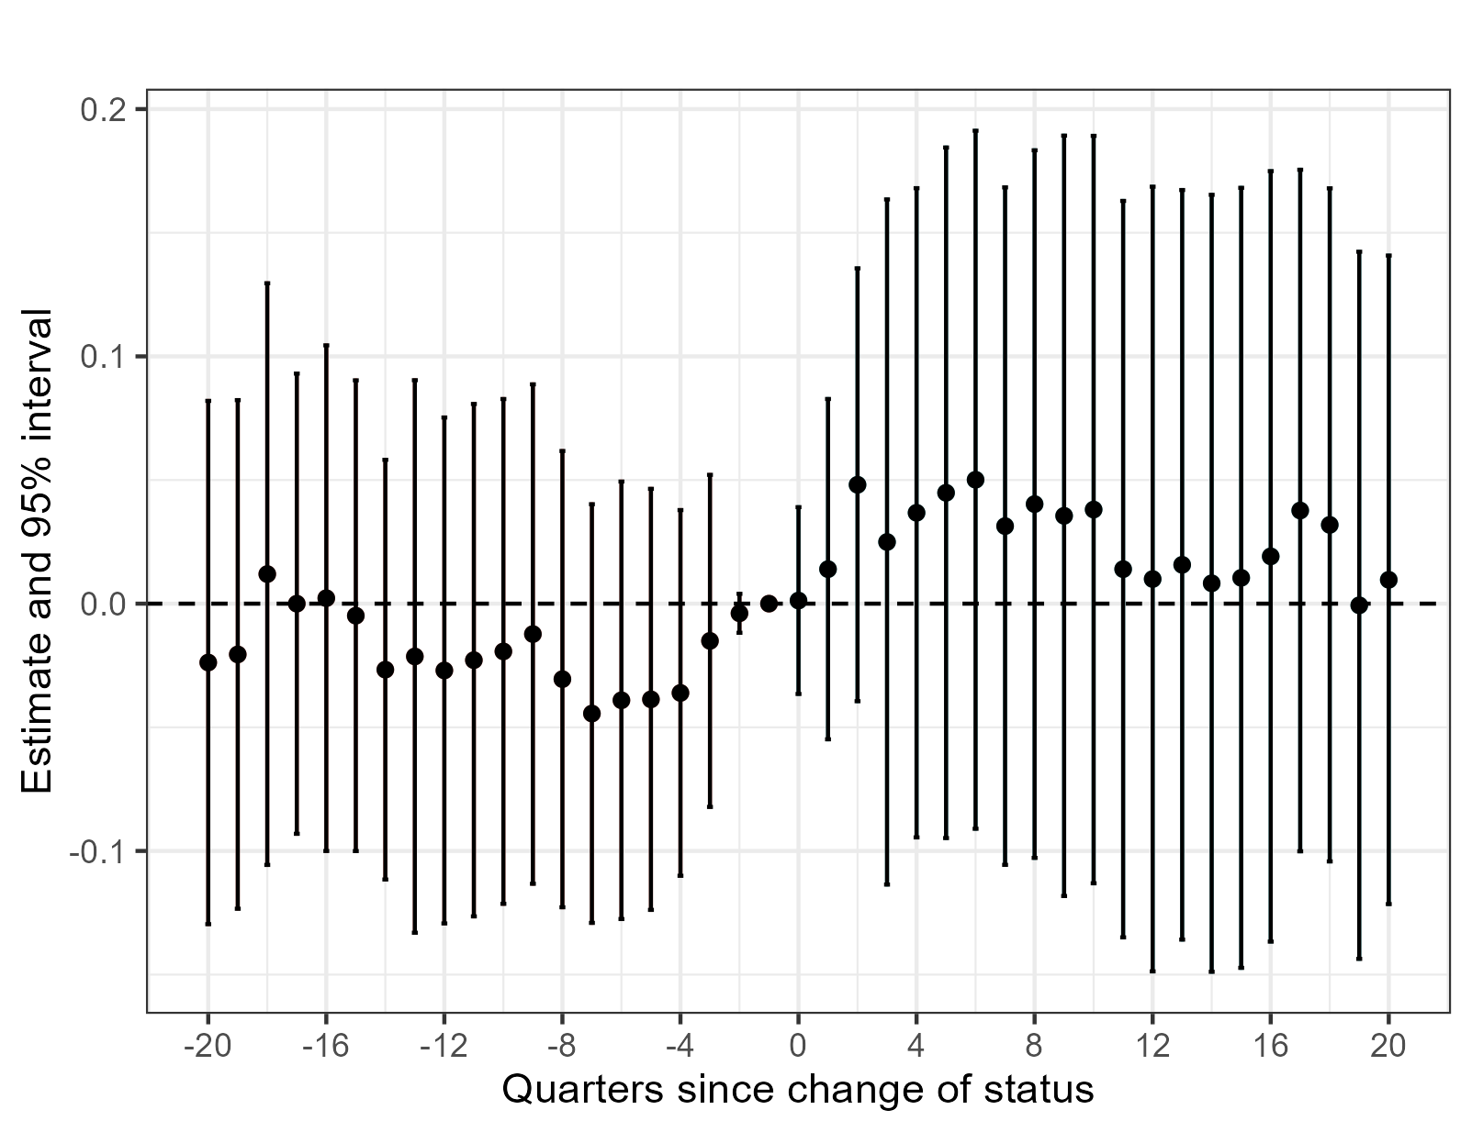
Off-vs On premise

Slide 6
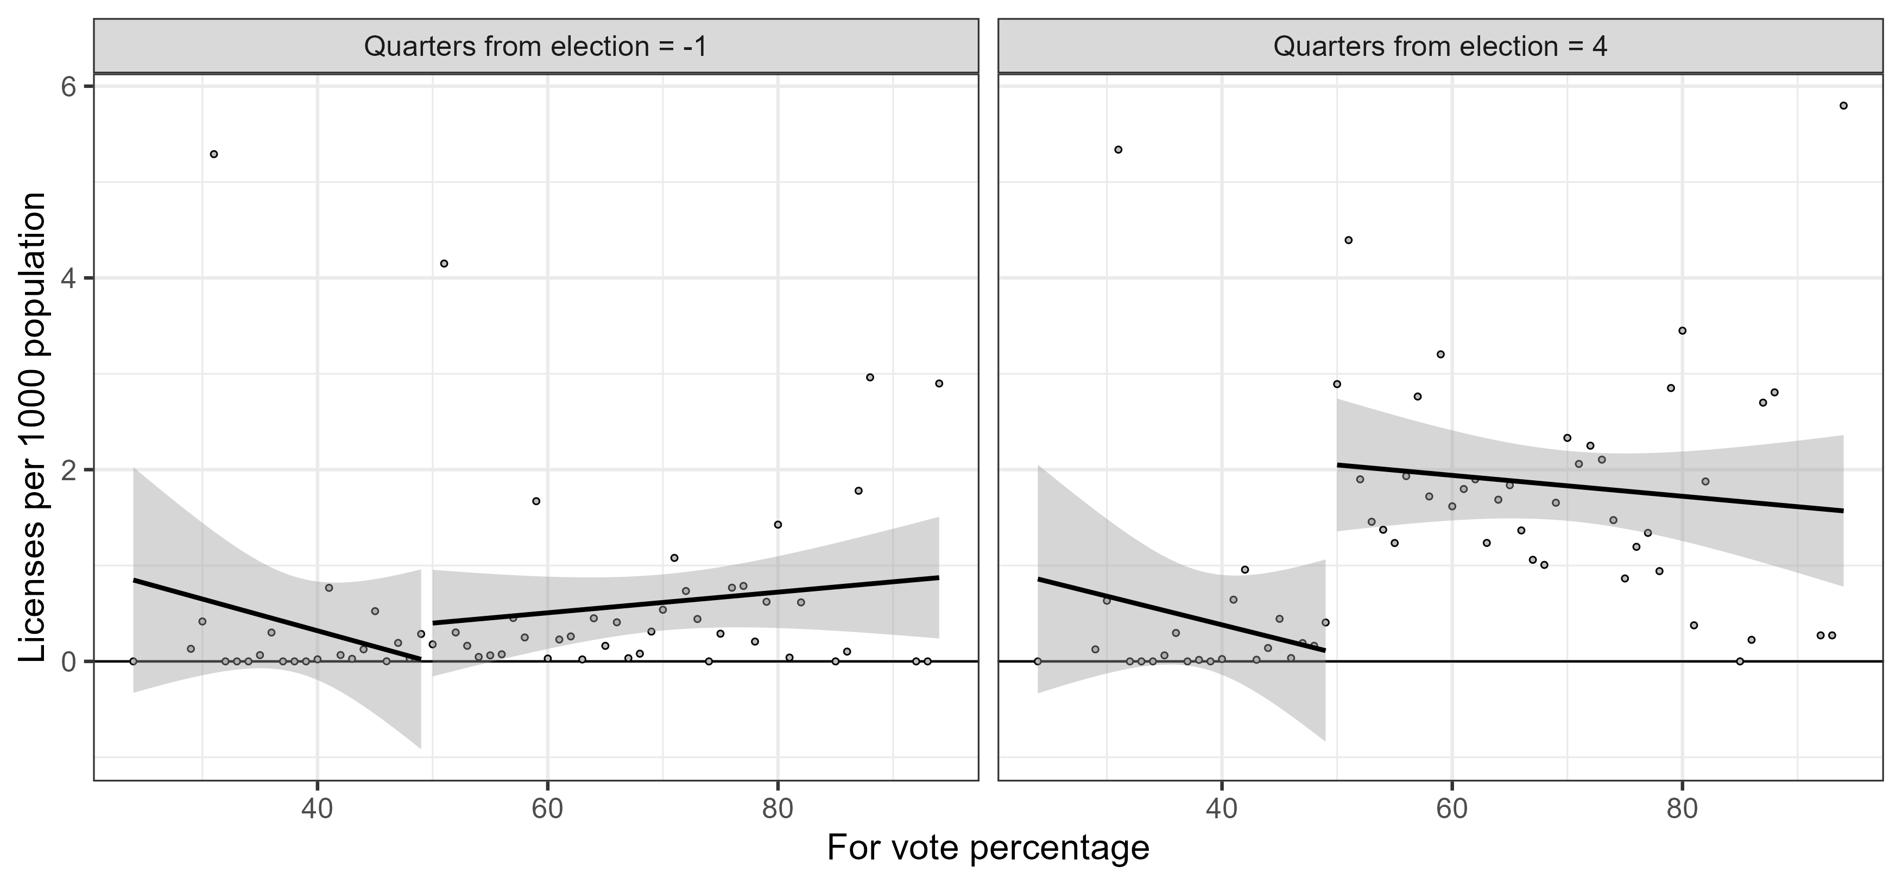
First-Stage results from the policy change (Vote share RD)

Slide 7
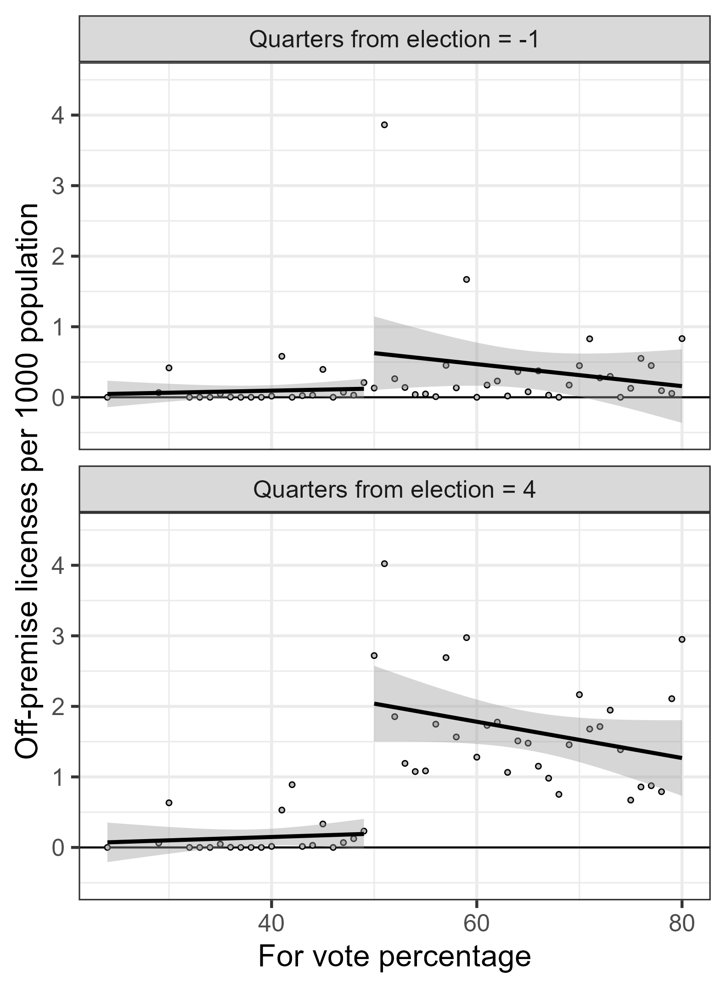
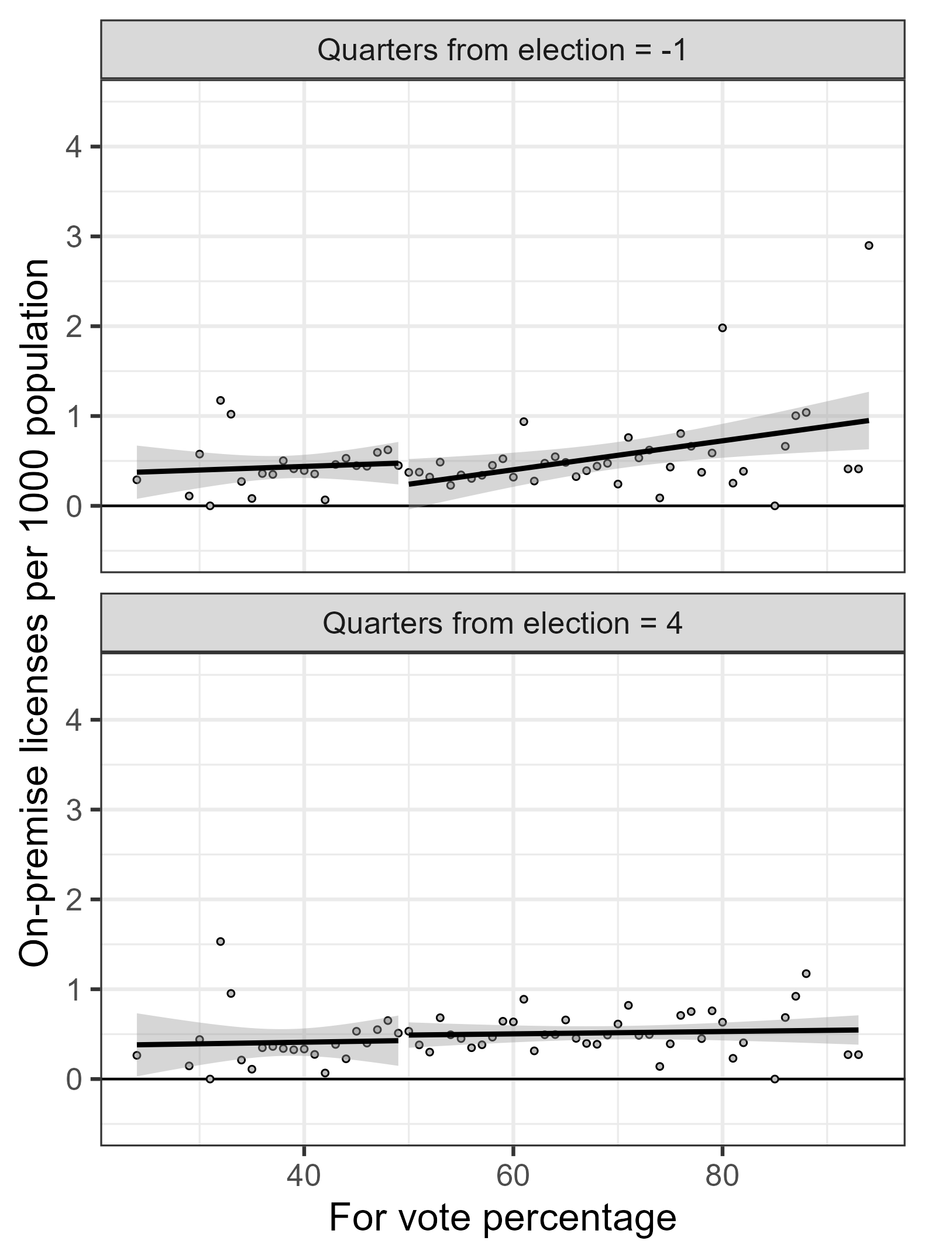
Off-premise vs on-premise

Slide 8
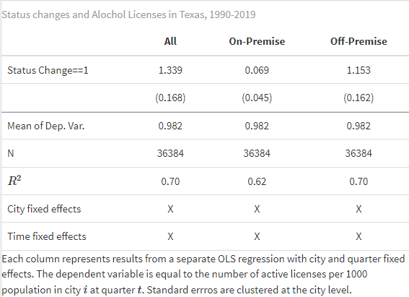
Regression Table

Slide 9
Story till now…
Change in status from being a dry area to a wet area increases the number of establishments that sell alcohol in that area.
When we decompose the increase, it seems that it is mostly the number of off-premise licenses that are increasing. Goes against previous result in EJ paper (they find an increase in on-premise licenses, and no increase in off-premise)
Robust? Did not look at ‘unique’ drinking establishments. Sometimes a single establishment can have multiple licenses. However, no reason to presume that this only affects off-premise establishments.

Slide 10
Licenses increase- what about actual sales?
Administrative data on monthly on-premise alcohol sales
Alcohol sales are very seasonal – for now I aggregated to annual sales, and inflation adjusted to 2010 prices
Can observe liquor, beer and wine sales

Slide 11
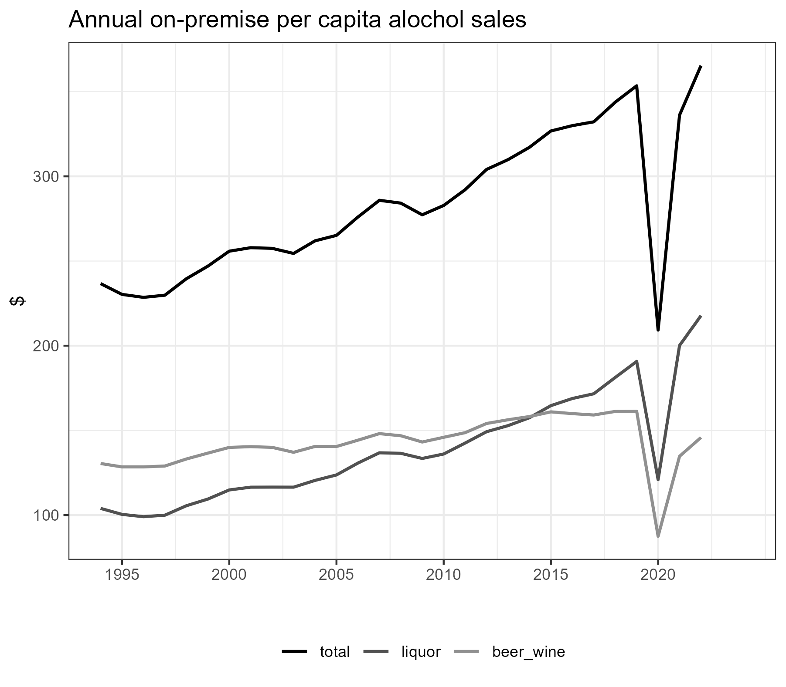
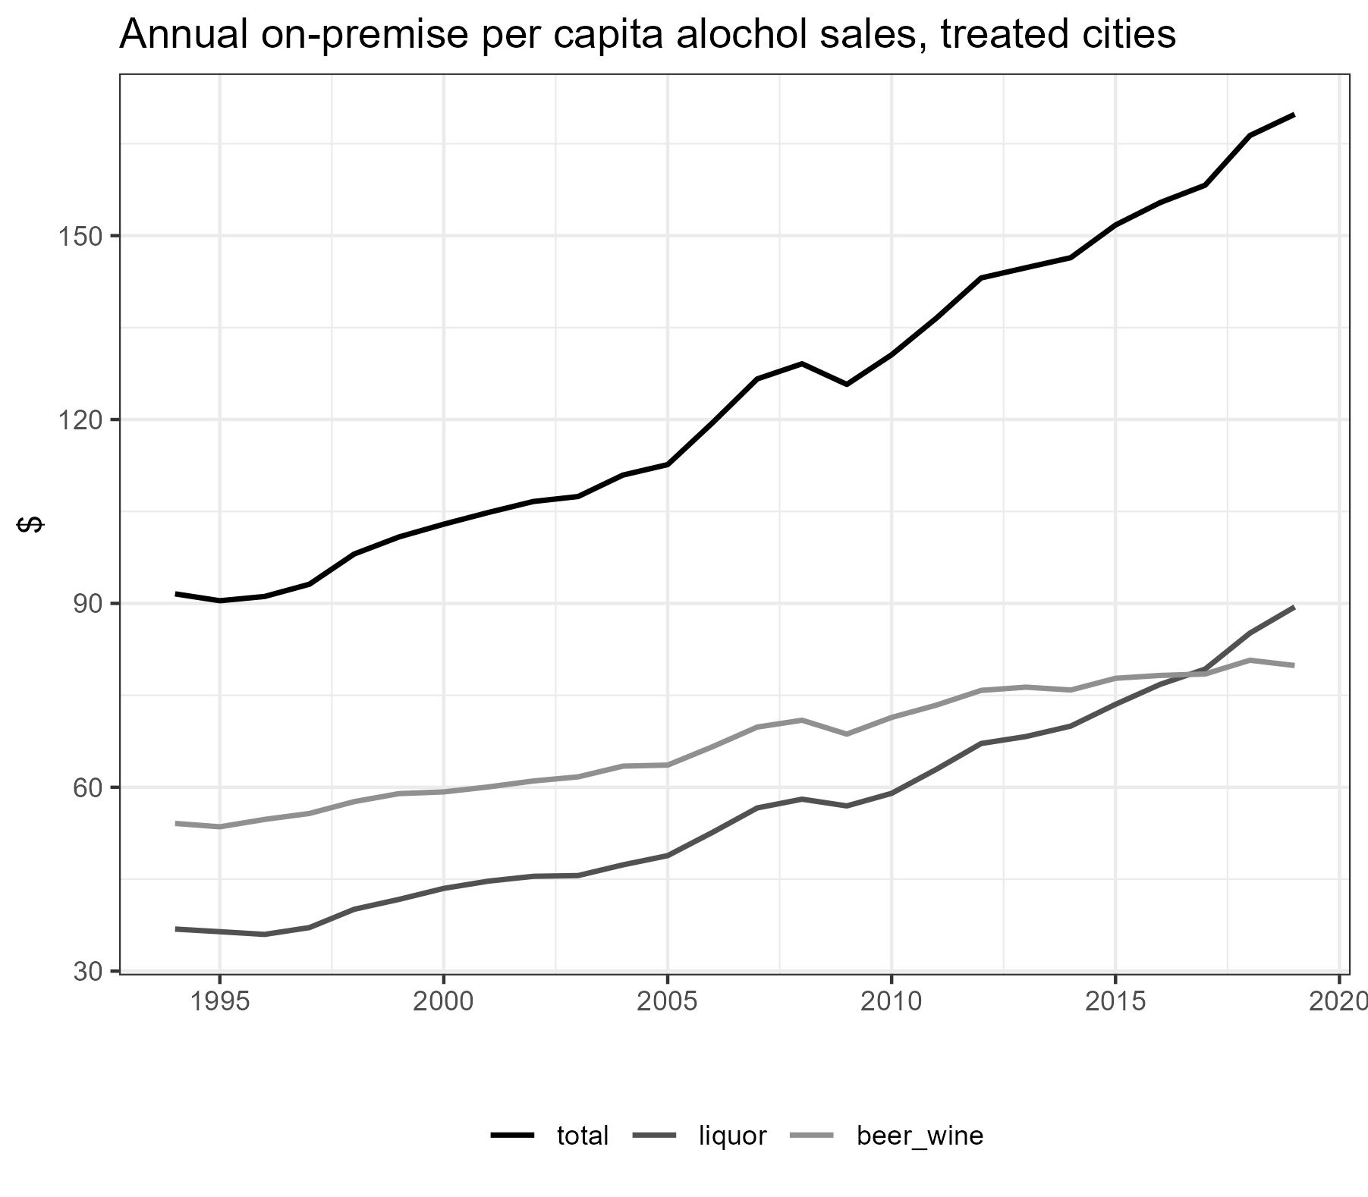
Alcohol sales trends

Slide 12
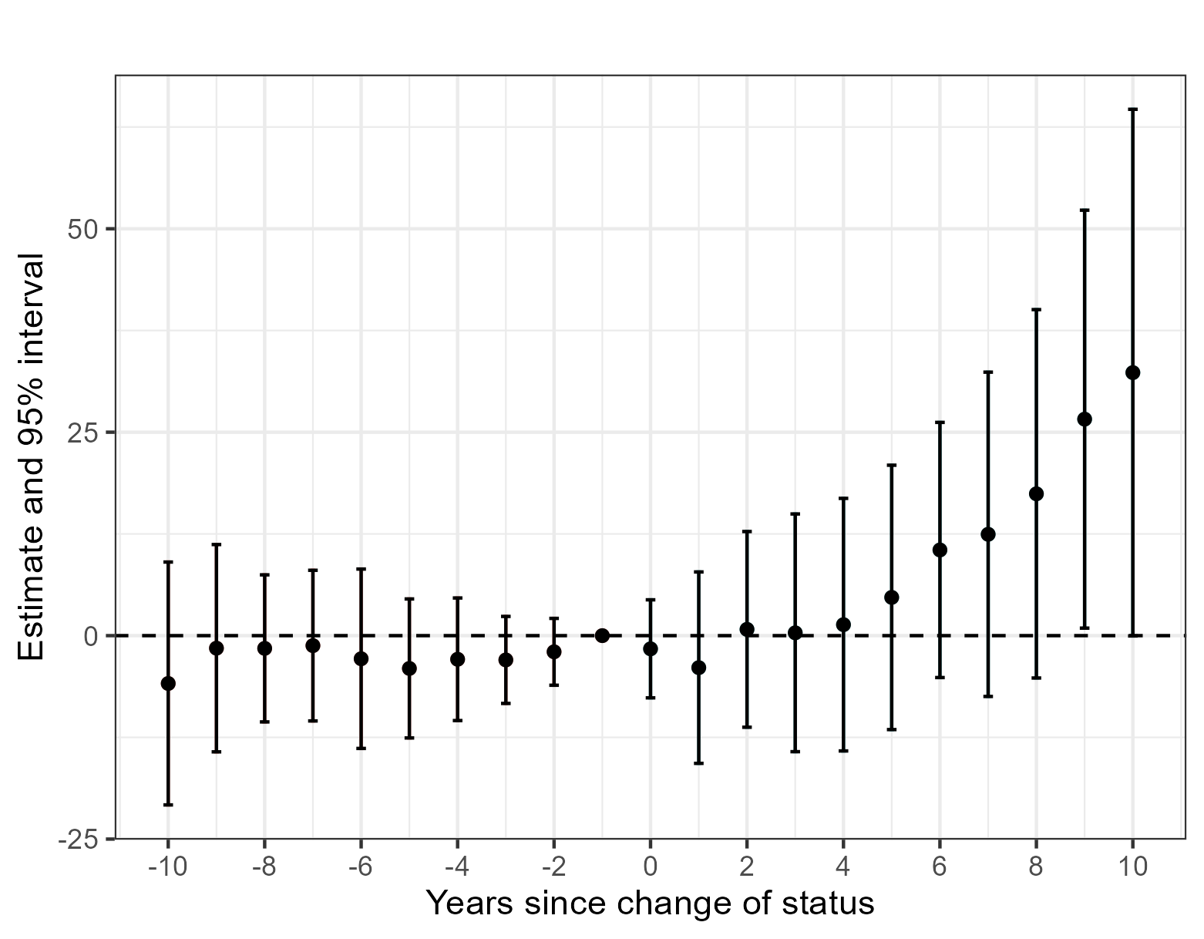
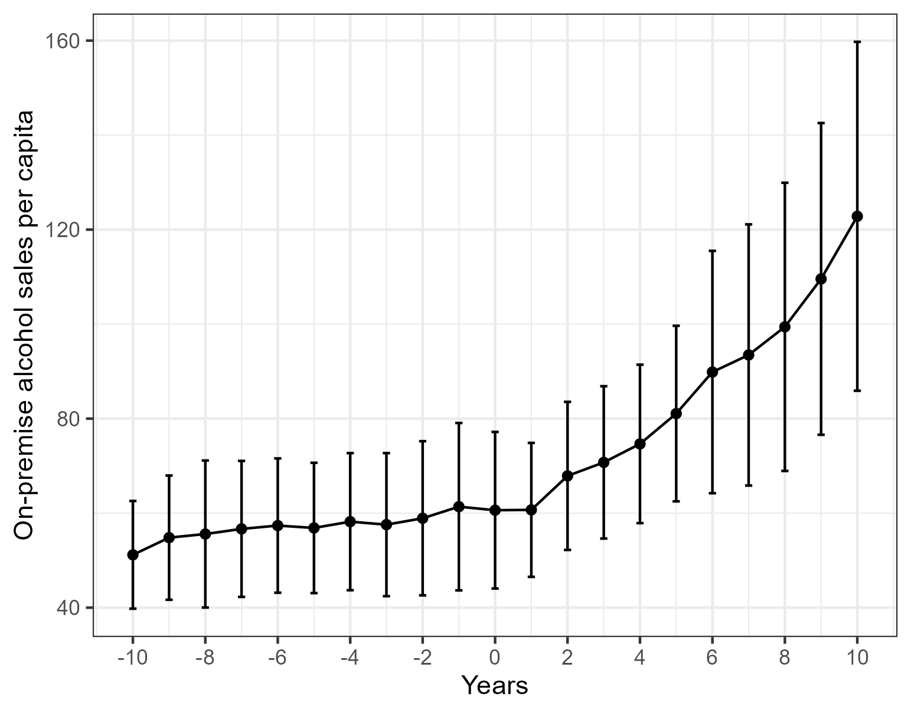
Event study- On-premise alcohol sales

Slide 13
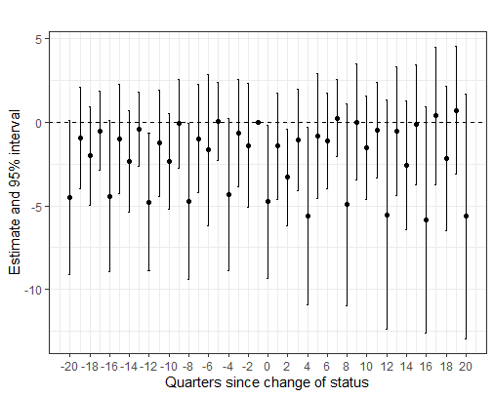
Quarterly sales instead of annual
This is from CS estimator, weird seasonality going on
Basic event study with quarter*year fixed effects
But no control!

Slide 14
Some observations-
Status changes do not affect on-premise sales, for upto 4-5 years
R-D results suggests no increase in sales
We see uptick in sales in the longer run -> many of these places are having an election again -> legalizing sale of on-premise sales
Lets check the licenses analysis – but over a longer time horizon

Slide 15
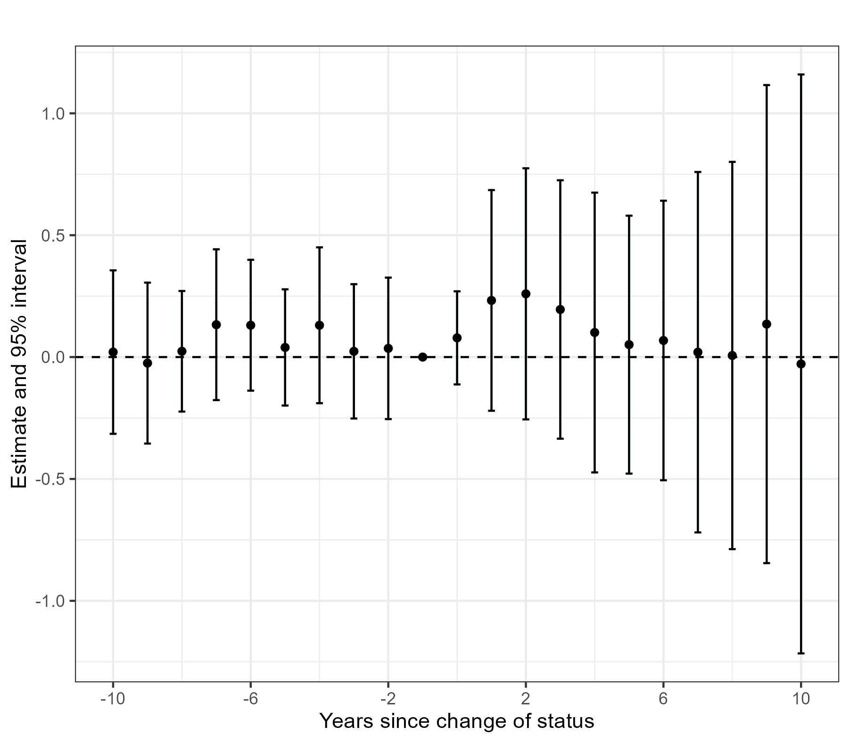
Event study of on-premise licenses, yearly
No clear increase in on-premise licenses even in longer time horizon
The increase in on-premise sales is not resulting from the status change as the status change directly affects only liquor licenses.
Increase in sales can be also too small to be meaningful
Should I check off-premise sales (from Nielsen data)

Slide 16
Next Steps?
First order effect of the policy – increase in off-premise licenses in newly wet cities
On-premise licenses/alcohol sales is mostly flat, or small increase
Outcomes only/more affected by off-premise consumption?
Traffic crashes (Tong is working on that)
Severe alcohol-related health issues (off-premise consumption of alcohol is cheaper)
Teen drinking should be exclusively off-premise
Crime should not be affected (no bar fights)

Slide 17
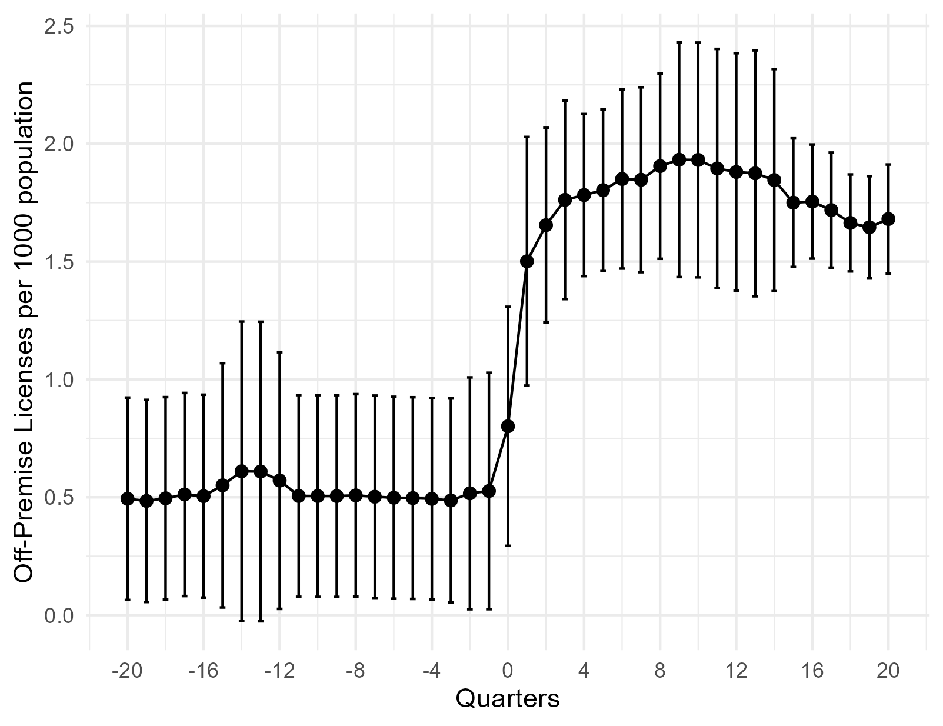
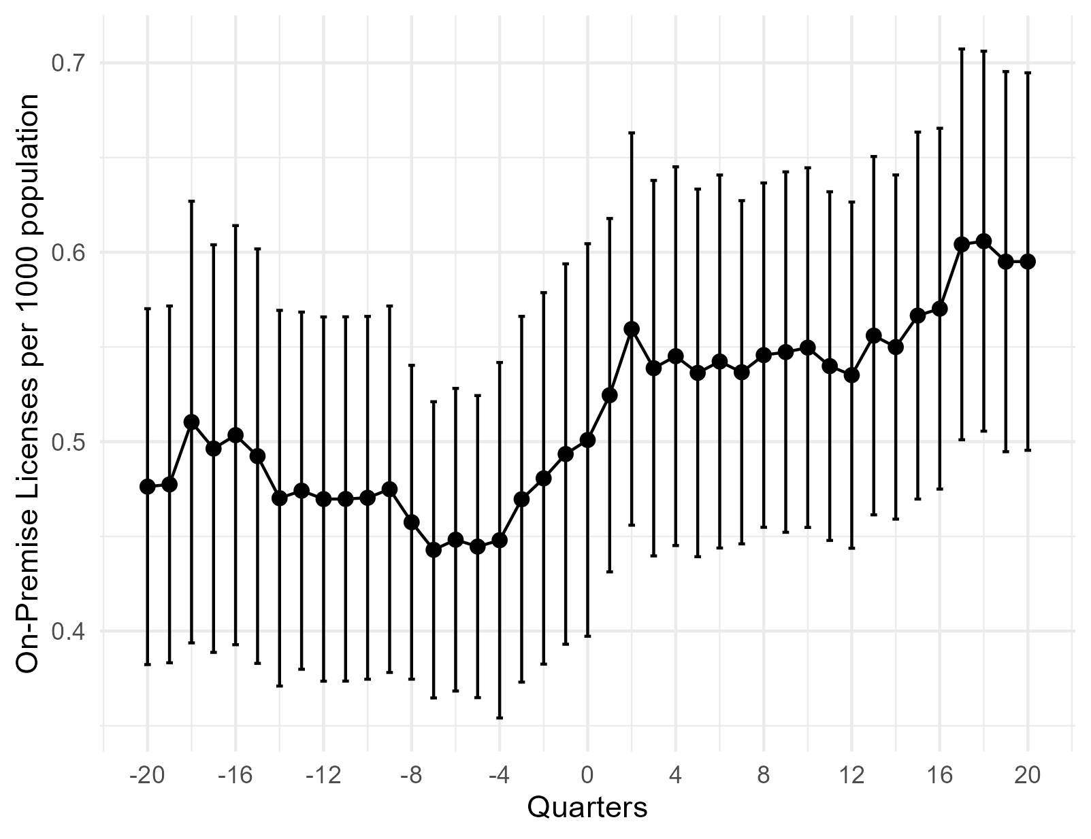
Raw data (off vs on premise)

Slide 18
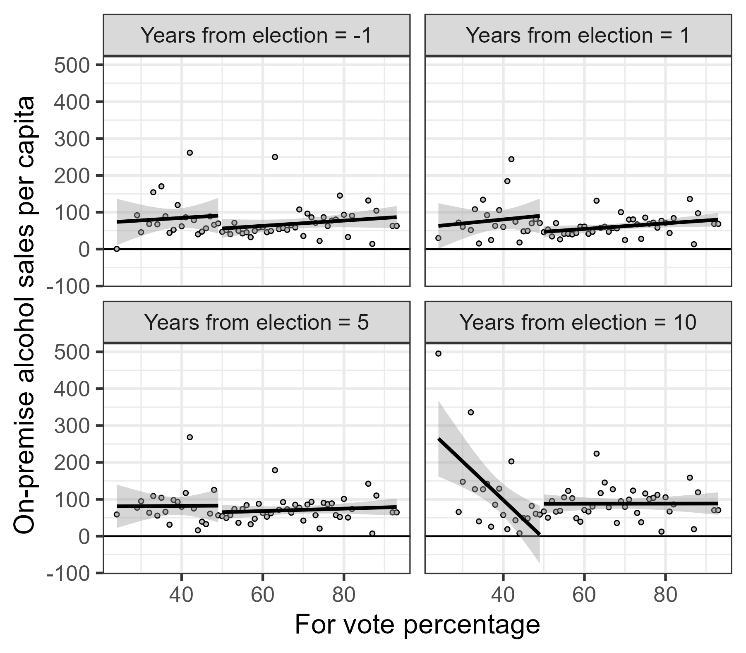
Vote share RD – Alcohol sales

Slide 19
